Slide 1

Credit Risk Analysis for a car loan company
Presented by: Supriya Prasad

Slide 2
Agenda
1. Introduction and Objective
2. Pricing
3. Customer Conversion Rate
4. Profit Margin
5. Recommendation
6. Other factors to consider
7. Recommendations for Future
8. Conclusion

Slide 3
Introduction
In this presentation, we delve into financial performance of a hypothetical car lending company, CarPro, focusing on its pricing strategy and customer conversion metrics. Our analysis aims to address critical questions related to CarPro’s profit margins on vehicle sales and financing, the impact of APR and FICO scores on these margins, and how different strategies affect overall conversion rates and profitability.
Objective:
Evaluate CarPro’s overall margin strategy.
Analyze the impact of APR and FICO score on customer conversion and profit margins.
Answer key problem statement questions.

Slide 4
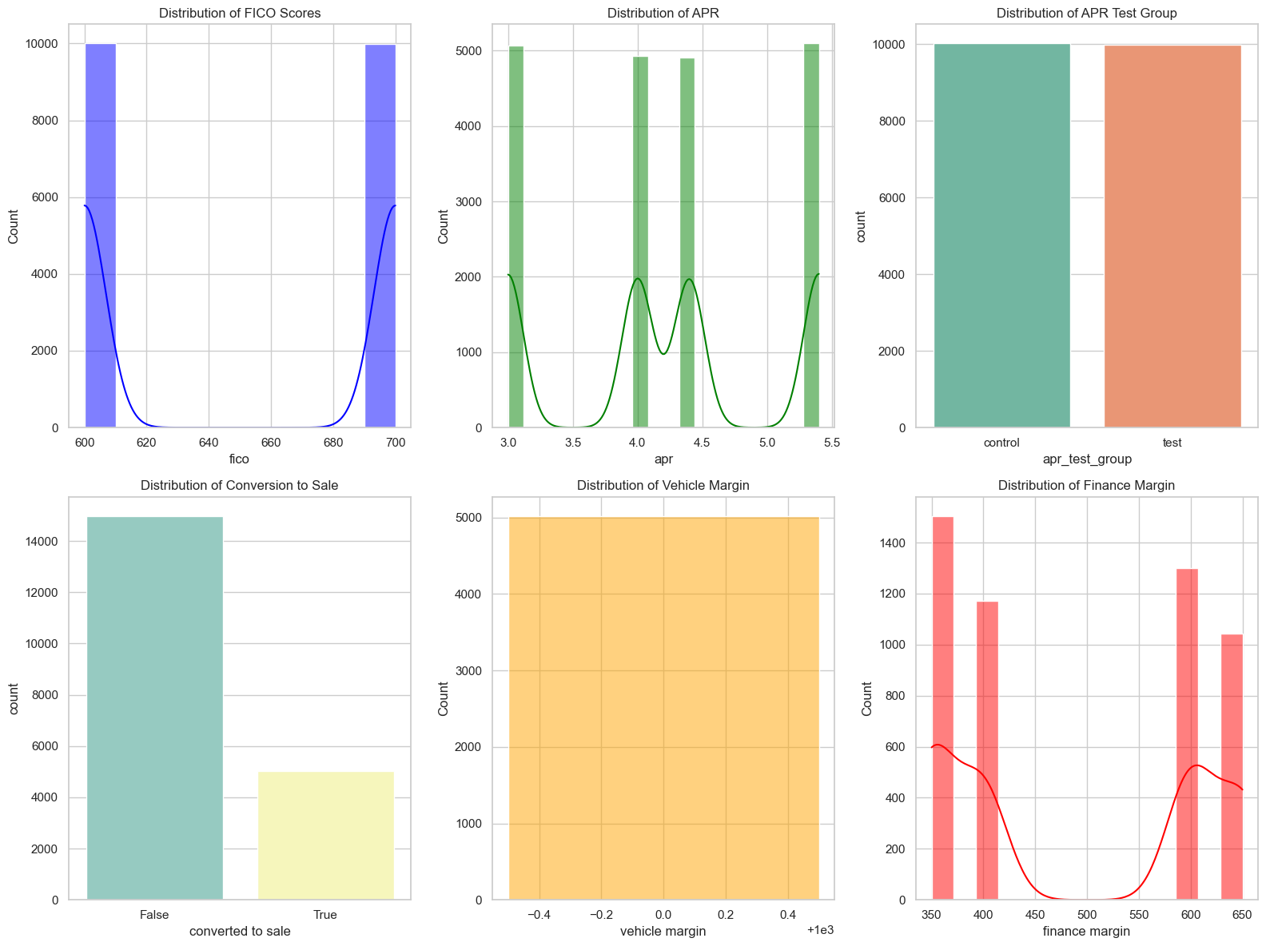
Understanding the Data
Fico scores are either 600 or 700
APR depends on FICO score and team is testing the margin by reducing the APR by 1%
APR test group is randomized and assigns about 50% of the applications to test group
23% of overall applications convert into a sale
All sales have fixed vehicle margin of 5000 and a variable finance margin that depends on the APR

Slide 5
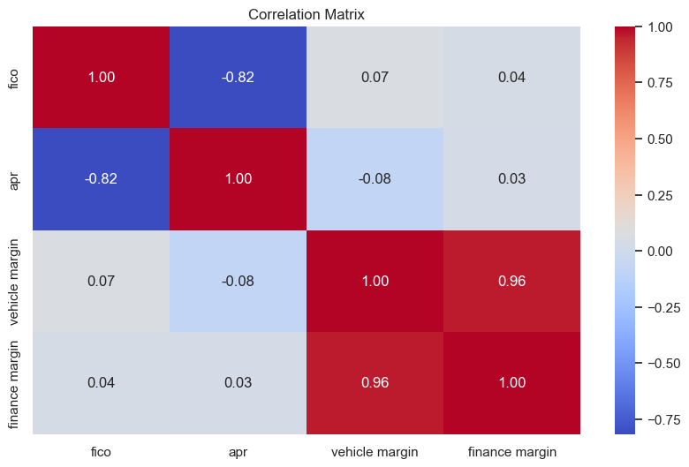
Understanding the Data – Correlation
There is a strong negative correlation between FICO scores and APR (-0.82). Higher FICO scores are generally associated with lower APR values.
There is a very strong positive correlation between vehicle margin and finance margin (0.96). This suggests that increases in vehicle margin are closely associated with increases in finance margin.
The correlation between APR and both vehicle margin (-0.08) and finance margin (0.03) is weak. This indicates that changes in APR have minimal direct impact on vehicle or finance margins.

Slide 6
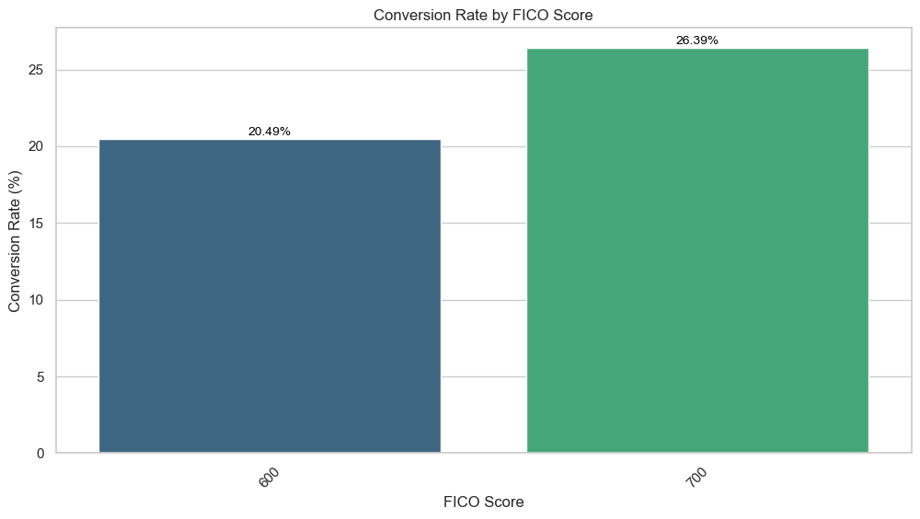
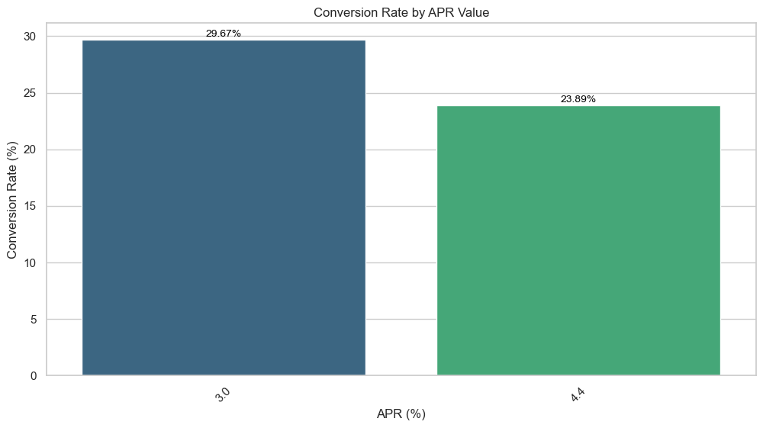
Conversion Rate Analysis: FICO and APR Impact
Overall Conversion Rate:
CarPro converts 2,344 applications out of 10,021, resulting in an overall conversion rate of 23.39% for the control group.
Key Insight:
FICO score and APR have a one-to-one relationship in the APR test group, leading to similar conversion rate patterns for both metrics.

Slide 7
Overall Margin Analysis
Overall Margin per Sale: $1622.27
This robust margin indicates that CarPro’s sales strategy is effectively contributing to profitability. It reflects the company's ability to maintain healthy profit margins despite potential fluctuations in costs or market conditions.
Overall Margin per Application: $379.46
This margin highlights the value of each customer interaction and the effectiveness of CarPro’s conversion processes. It demonstrates that even non-converted applications contribute positively to overall profitability, reflecting a strong conversion funnel and customer acquisition strategy.
Strategic Implications:
Optimizing Margins:
Focus: Enhance strategies that drive up vehicle and finance margins while maintaining or reducing costs.
Enhancing Application Efficiency:
Strategy: Improve the application-to-sale conversion rate to increase profitability per application.

Slide 8
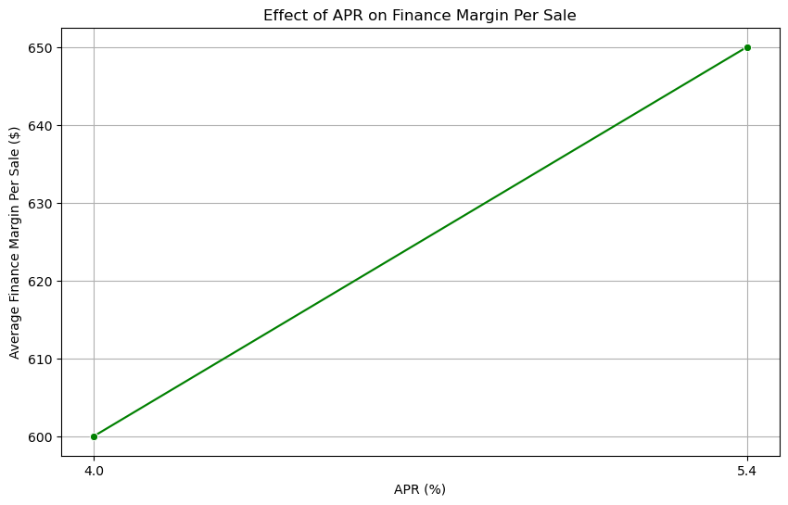
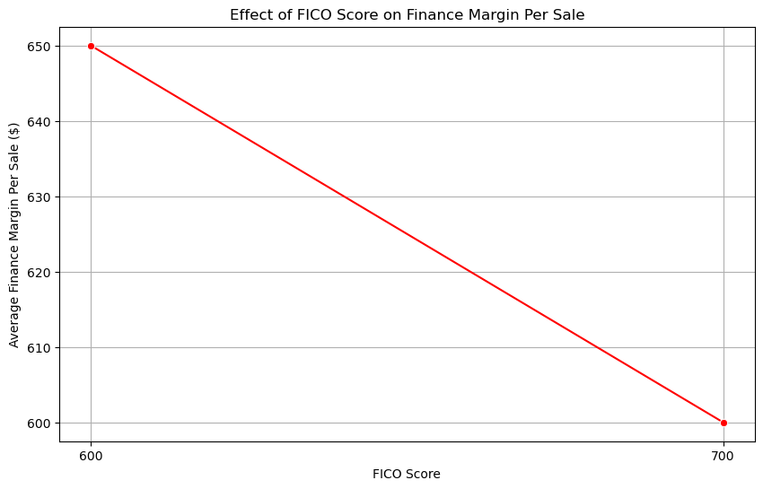
Effect of APR and FICO on Finance Margin
Higher APR leads to increased finance margins, benefiting the company's revenue from financing.
Higher FICO Scores lead to decreased finance margins, reflecting lower profitability from customers with better credit.
Finance margin decreases as the FICO score increases. Customers with higher credit scores receive better financing terms, leading to reduced profit margins from these financing deals.

Slide 9
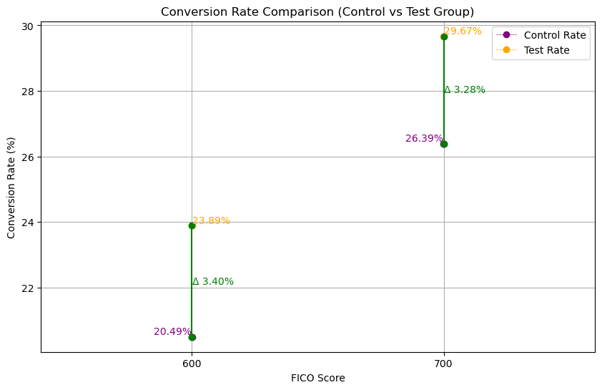
Conversion Rate by FICO Score (Control vs. Test Group)
Both FICO score segments show an improvement in conversion rates for the test group compared to the control group.
FICO 600: The test group saw a 3.40% increase in conversion rate.
FICO 700: The test group saw a 3.28% increase in conversion rate.
The increase in conversion rates suggests that the test strategies are beneficial. Consider implementing these strategies more broadly.
Focus on optimizing strategies further for both FICO score ranges to maximize conversion rates and overall performance.

Slide 10
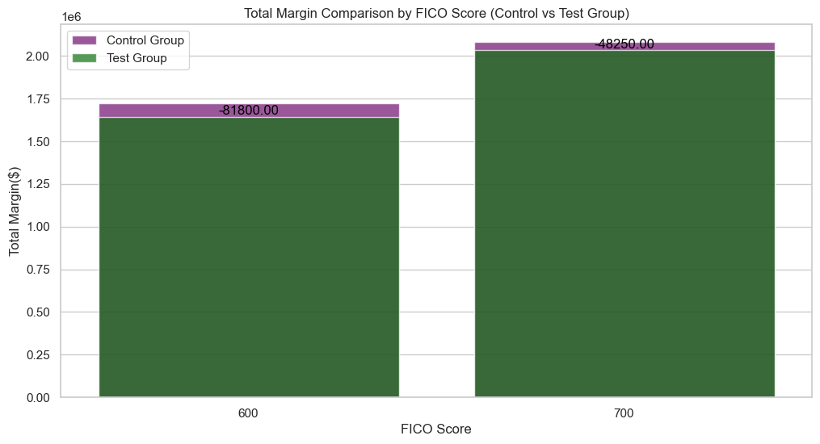
Total Margin Comparison by FICO Score (Control vs Test Group)
Both FICO score segments show a reduction in total margin for the test group compared to the control group.
FICO 600: A decrease of $81,800
FICO 700: A decrease of $48,250
The decrease is understandable due to the reducing APR affecting the Finance Margin

Slide 11
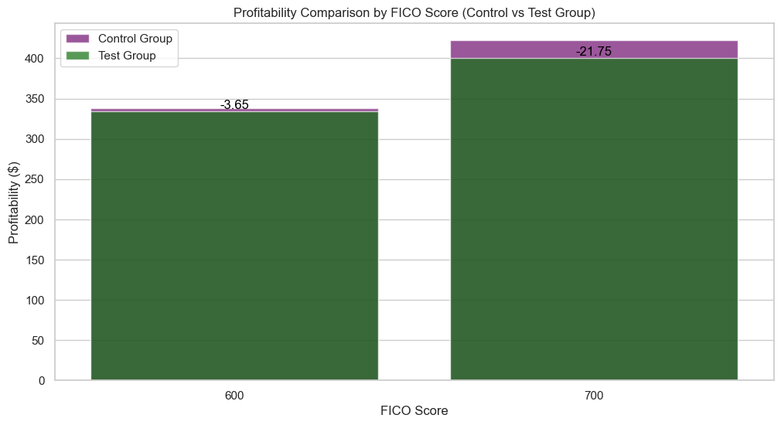
Profitability per Application by FICO
Profitability Trends:
FICO 600: Shows a slight decrease in profitability for the test group compared to the control group.
FICO 700: Indicates a more notable decrease in profitability in the test group.
The reduction in profitability across both FICO score segments suggests that the test interventions may have negatively impacted profitability.
FICO 700 experiences a larger drop, which could be due to a greater sensitivity of higher credit score segments to the test changes.

Slide 12
Recommendations
Summary:
CarPro’s margins are healthy but are influenced by customer financing behavior.
APR adjustments improve conversion rates, but reduce finance margins.
Lower APRs have a more significant effect on customers with lower FICO scores.
Recommendation:
Based on the analysis, we could consider targeting lower APR offers to boost conversion rates for customers with lower FICO scores while managing the margin impact.
For Lower FICO Scores: Offer lower APRs to increase conversion rates and attract high-potential customers. This will help capture more sales and potentially improve overall profitability despite a lower margin per sale.
For Higher FICO Scores: Maintain higher APRs to maximize finance margins, as these customers are less sensitive to APR changes.

Slide 13
Other factors to consider for Recommendation
Some factors to consider for recommendation are:
Lower APRs may increase the volume of financed sales, but this impacts the cost structure for the company as a whole; hence, there is a need to assess what CarPro will take on in terms of financing costs.
Runs the risk of higher delinquencies or defaults with lower APRs. Perform historical data analysis for the tendency of lower APRs reflecting into higher default rates.
Ensuring that this short-term win in conversion rates is not translated into unsustainable losses over time.
Consider how APR changes might affect CarPro’s brand perception. Offering lower APRs might attract more customers but could also impact the perceived value of your services.
Brand positioning among competitors is also dependent on this so maintain a good APR pricing in comparison to competitors and still maintain profitability.
Identify the sensitivity of different customer segments to APR changes. Identify the APR level, which can help maximize the conversions without significantly impacting margins.

Slide 14
Recommendations for Future
Consider lowering APR on low risk and maximum profitable applications on a restricted/ case by case basis:
Some of the scenarios to consider are:
Tenure of financing
Considering credit length and history along with FICO score.
Analyze vehicle that offer good profit and offer lower APR based on vehicle types.
Offer lower APR on vehicles that are on inventory for long time.
tenure of the loan.
credit history and credit length
lower intrest rate based on the type of the vehicle.

Slide 15
Conclusion
Lower APRs boost conversion rates, especially for lower-FICO customers, but reduce finance margins.
Higher APRs maintain profitability for higher-FICO customers with minimal impact on conversion rates.
Recommendations:
Target lower APRs for lower-FICO customers to increase conversions while managing margin impact.
Maintain higher APRs for higher-FICO customers to maximize finance margins.

Slide 16
Thank You

